Slide 1
Module 5: Leader of the Free World
Talk | Title | Time Period | Date of Talk
30 | Isolationism interrupted | 1939-1941 | January 20th
31 | The European War | 1941-1945 | February 3rd
32 | The Pacific War | 1941-1945 | February 17th
33 | America and the Post War World | 1945-1949 | March 3rd
34 | USA during the 1950’s | 1950-1960 | March 17th
35 | The Cold War | 1950-1960 | March 31st
36 | Camelot…the Kennedy Years | 1961-1963 | April 7th

Slide 2
Talk 33 USA and the Post War World (1945-1949)
Peace & Post War World
Post war USA
Birth of Cold War
….Intermission
Trouble in China
Election of 1948 and the Cold War

Slide 3
Peace

Slide 4
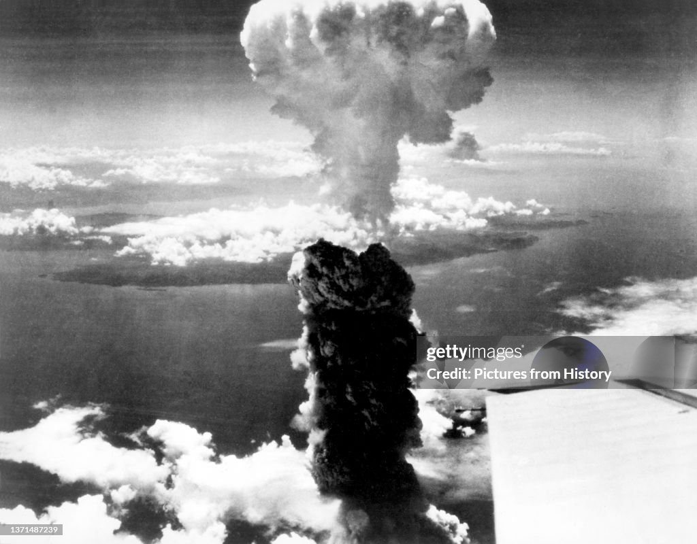
August 1945 World awaits invasion of Japan ….
Millions of deaths
expected
Then this happens
Suddenly,unexpectedly
…there is Peace

Slide 5
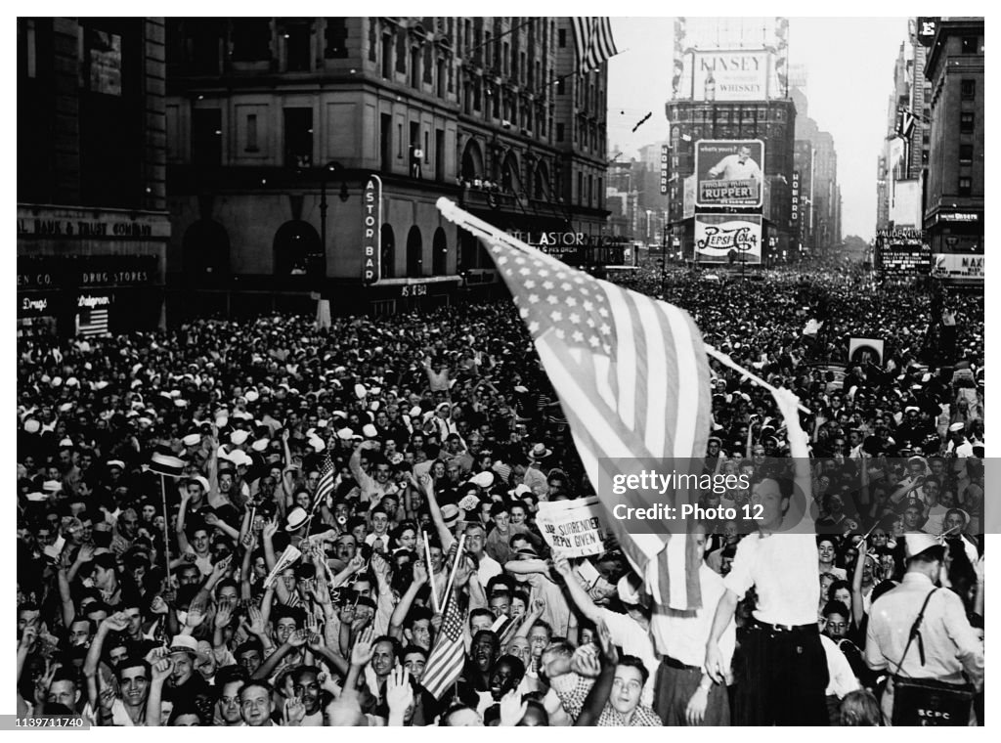
New York VJ Day Celebrations

Slide 6
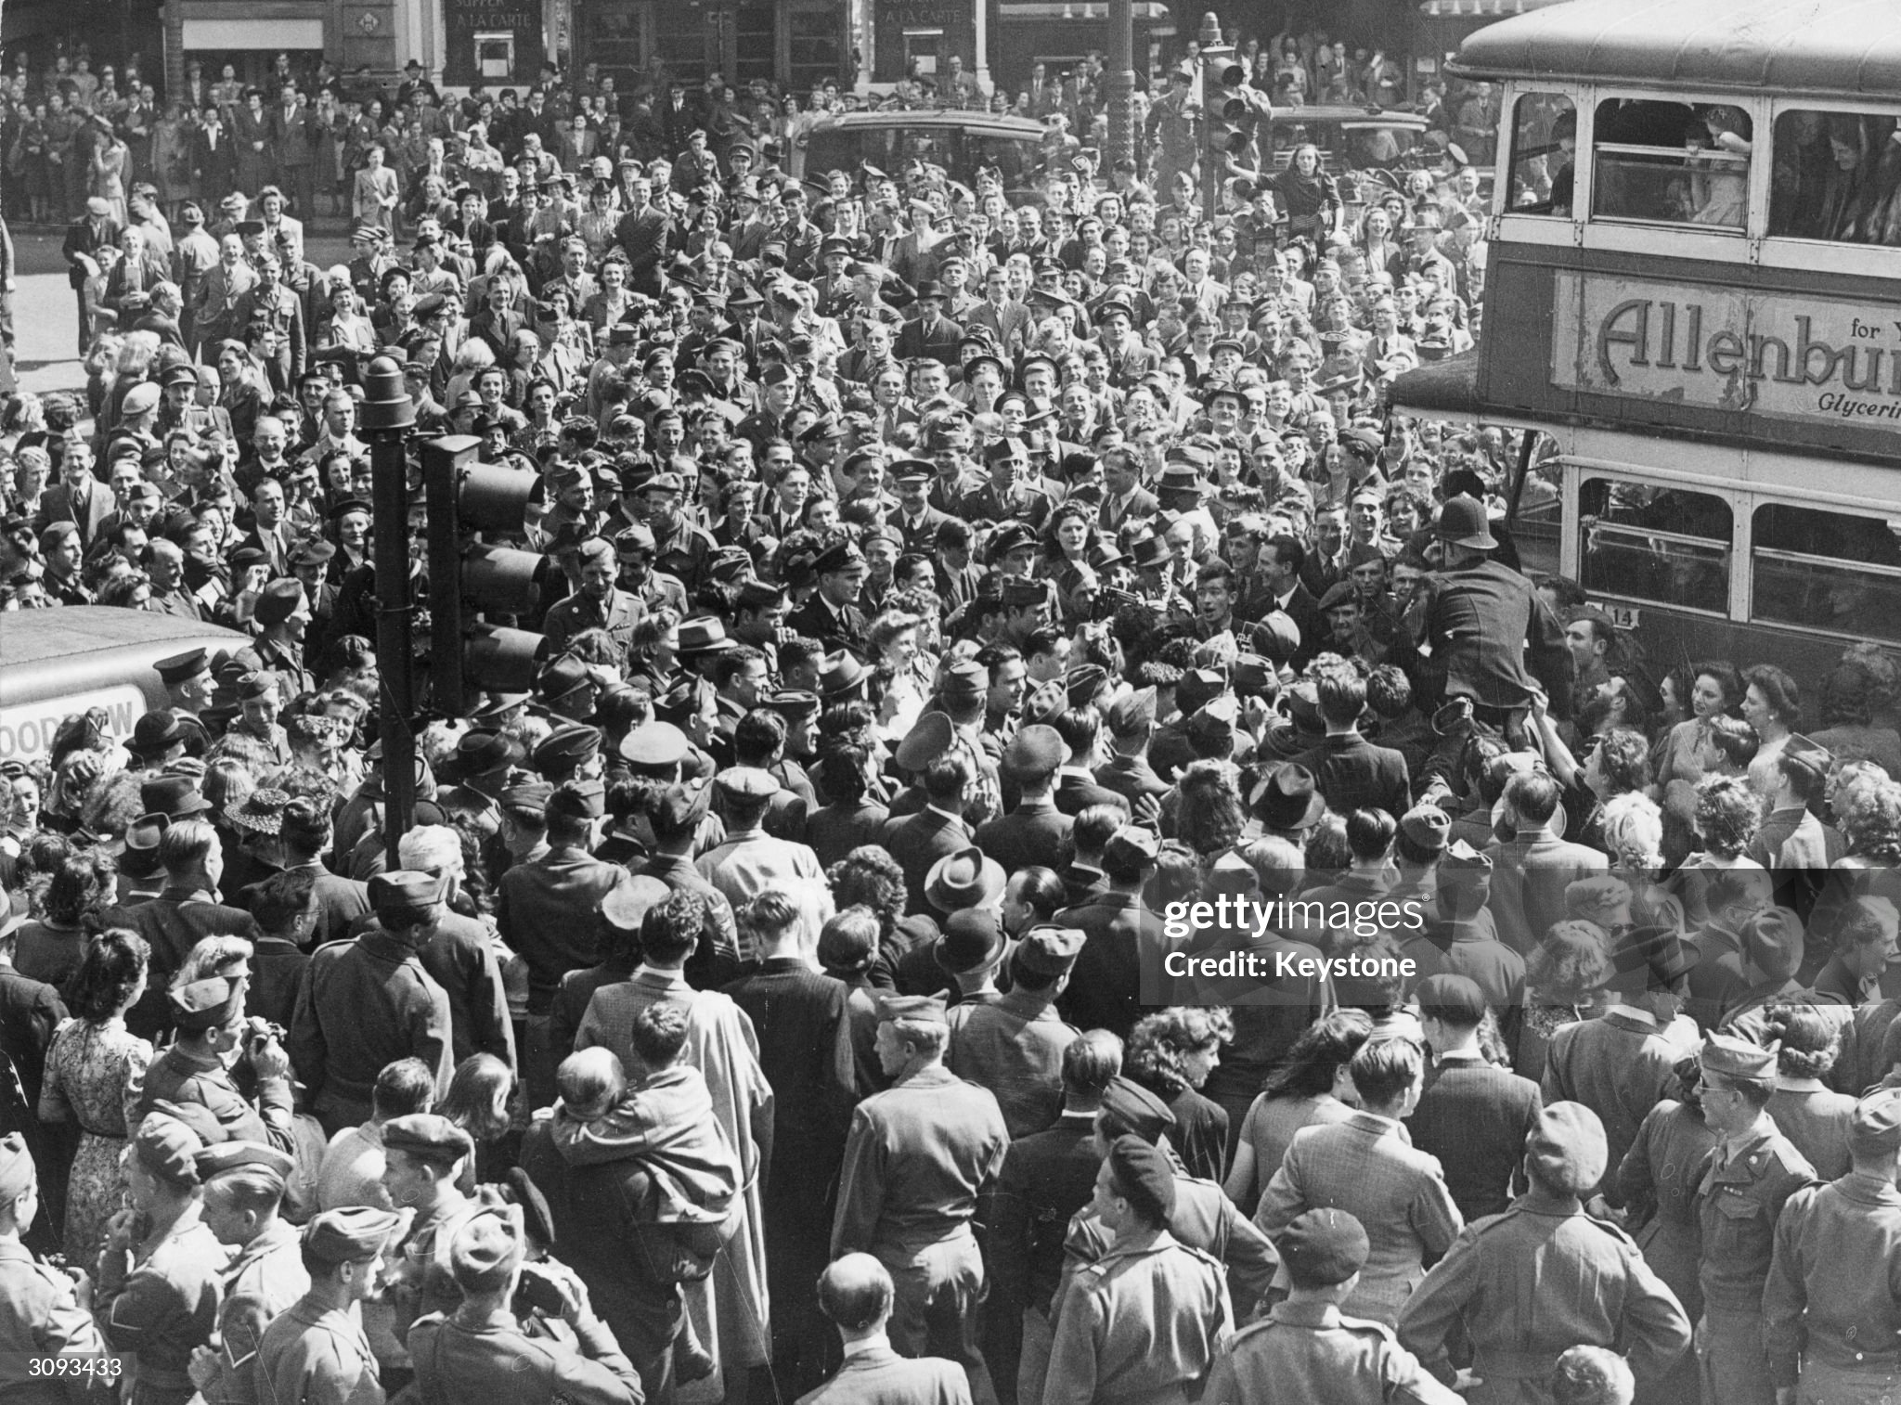
London VJ Celebrations

Slide 7
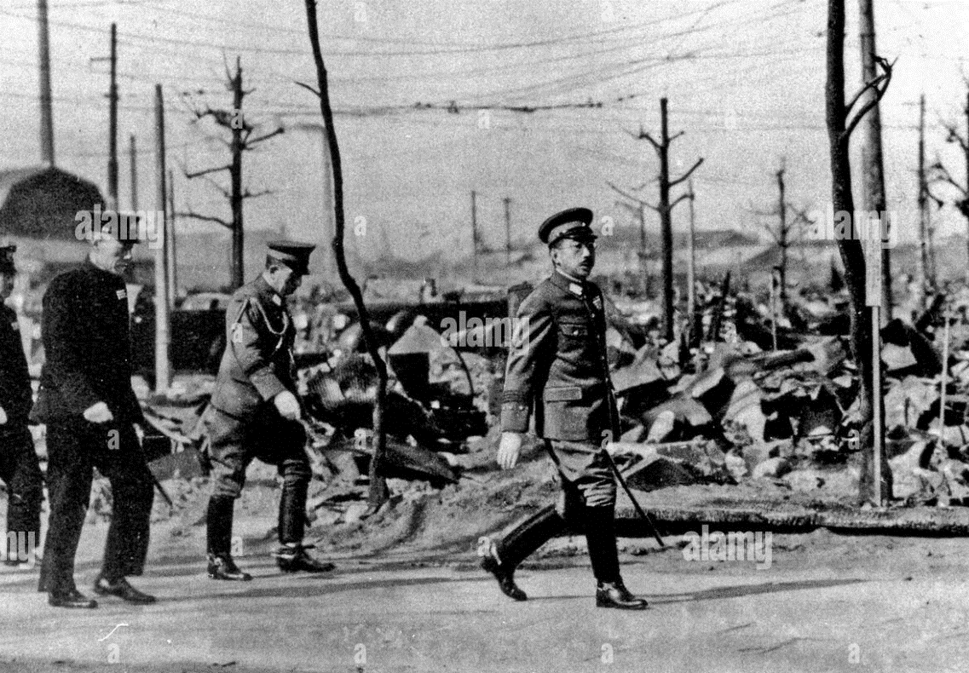
Japan: Emperor Hirohito on route to new boss Douglas Macarthur….to be honoured or hanged?

Slide 8
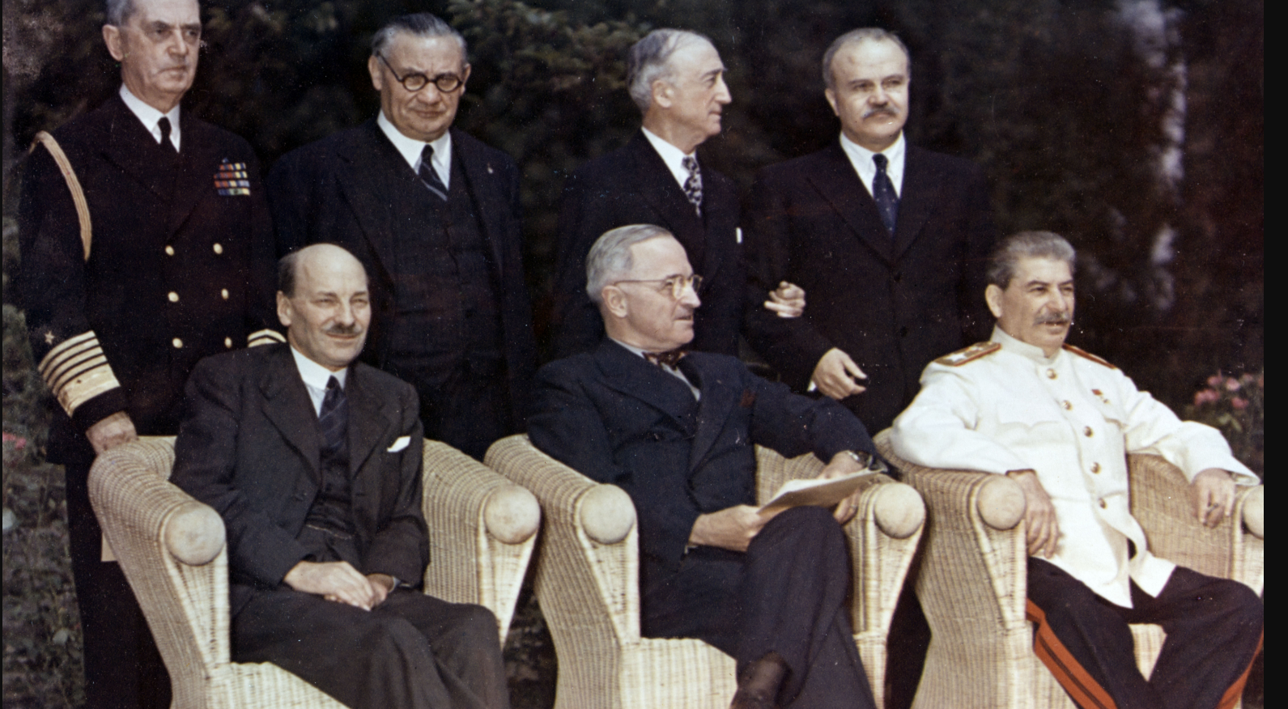
Potsdam Conference July/August 1945 …”Big 3” meet to design new world order
UK:
Clement Atlee
(replaces Churchill
The prior week!)
USA
Harry Truman
Place FDR since April
`USSR
Joseph Stalin
Dictator since 1928

Slide 9
Potsdam perceptions
Stalin
Seeks territorial expansion …Japan, East and Western Europe
Considers Truman “stock clerk”….dismisses as weak
Truman
Prepared to trust Stalin:“I can deal with Stalin. He's honest, but smart as hell”
Avoid failings at Versailles…stability and prosperity for USA
Atlee
Meet British obligations to stabilise Europe by transferring power to USA
Disengage from world conflicts/ focus on domestic concerns (NHS)

Slide 10
Potsdam: The New World Order
“Germany to be de-militarised and de-industrialised
Occupied by 4 powers (including France)
Germans in East Europe to be “humanely” relocated to Germany
Division of Europe East vs West as “zones of control”
Free and Fair Elections” in all liberated areas
Japan to be de-militarised and de-industrialised
Occupied by USA (800,000) and token 50,000 British/Australians
Peace to maintained by newly formed United Nations
No agreement: Financial systems and redevelopment

Slide 11
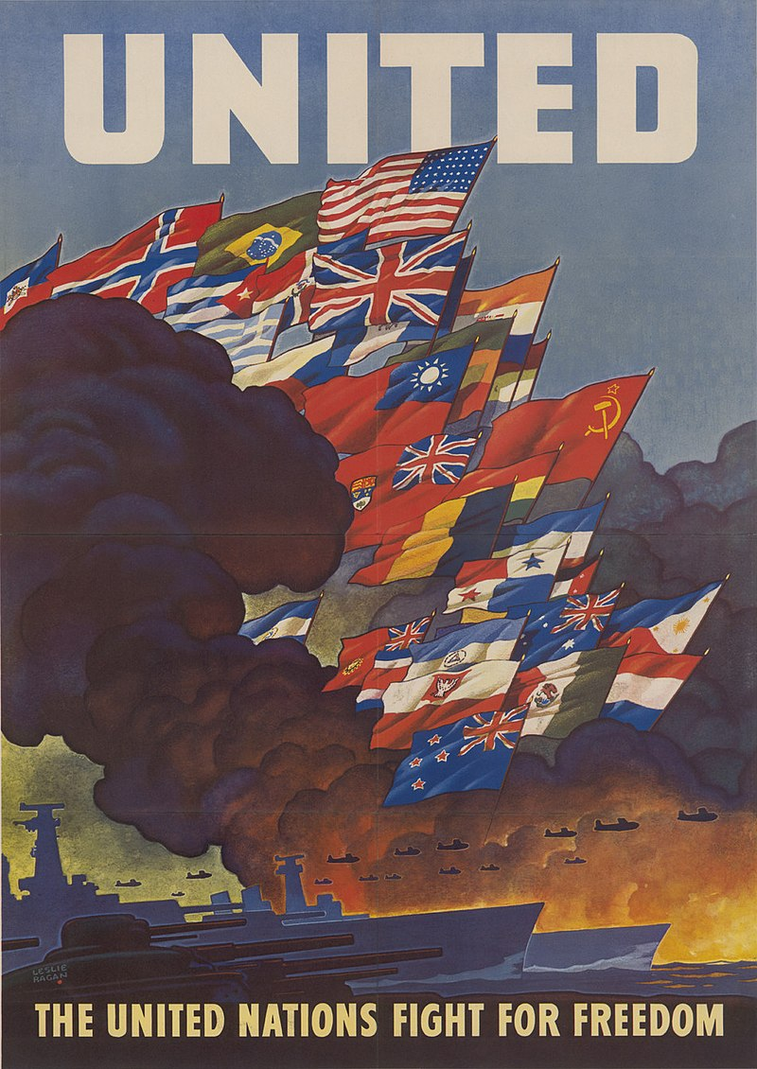
United Nations
UN Poster 1943
Proposed FDR “Atlantic Charter” 1941
Differences to League of Nations
….Security Council of Big 5
(USA, USSR, UK, France, China)
….Unified Army to intervene (veto)
UN meets April 1945 San Francisco
First task….humanitarian, process relocation of refugees

Slide 12
New World Financial Order
USA dominant economic power: 70% world gold, 25% trade,
….enormous trade surplus
Great Depression caused by protectionism, currency devaluations
Bretton Woods Agreement 1944….in place till 1971
New world economy to be based on US $ convertible to Gold
Fixed Exchange Rates
Managed reduction of tariffs (General Agreement on Tariffs
International Monetary Fund established to provide loans
USSR refuse to join….consider system “Wall Street Racket”
..remain committed to Command Economy

Slide 13
Post War World

Slide 14
The costs of war
Country | Population 1939 (m) | Deaths (M) | % Population
Poland | 35 | 6 | 17%
USSR | 189 | 26 | 14%
Nazi Germany | 83 | 7 | 8%
Japan | 71 | 3 | 4%
China | 518 | 18 | 3%
India (90% famine) | 377 | 3 | 1%
United Kingdom | 48 | 450,000 | 1%
United States | 131 | 407,000 | 0.3%
US least impacted
…: 5 civilian deaths only (after Pearl Harbour)

Slide 15
Economic Consequences
US economy – 50% total world output.
 | GDP 1939 $Bn (1990) | GDP 1945 $Bn (1990) | Change
USA | 869 | 1,474 | + 70%
UK | 287 | 331 | +15%
USSR | 366 | 343 | -6%
Germany | 411 | 322 | -22%
Japan | 184 | 144 | -22%
Urban devastation
Germany 40% buildings in 50 largest cities destroyed
Poland…30 of housing totally destroyed
Japan..40% housing totally destroyed, 30% urban population homeless
UK 30% of housing stock damaged/destroyed

Slide 16
Europe on brink of starvation
Average Daily Calorie Intake
 | 1939 | 1946 | Change
Germany | 3,300 | 900 | -72%
Italy | 2,700 | 1,700 | -38%
France | 2,500 | 1,700 | -32%
Japan | 2,100 | 1,300 | -38%
UK | 3,000 | 2,900 | -3%
USA | 3,500 | 3,300 | -5%
Farming area devastated……30% land unusable due to mines, destruction
Starvation during war prevented by US funded “Lend Lease”

Slide 17
Global Refugee crisis
500,000 Concentration camp survivors
Most want to go to Palestine…but British limit to 75,000
Quota rules limit immigration to USA
“Ethnic cleansing” taking place across Europe
13m Germans expelled from Eastern Europe. German territory transferred to Poland
2m Poles from Russian expansion form Ukraine, Belarus
5 million Japanese expelled from China, Korea, Manchuria
Millions of prisoners of war to be returned ..many to gualags/shot
Processed by Armies of Occupation, Charities, United Nations

Slide 18
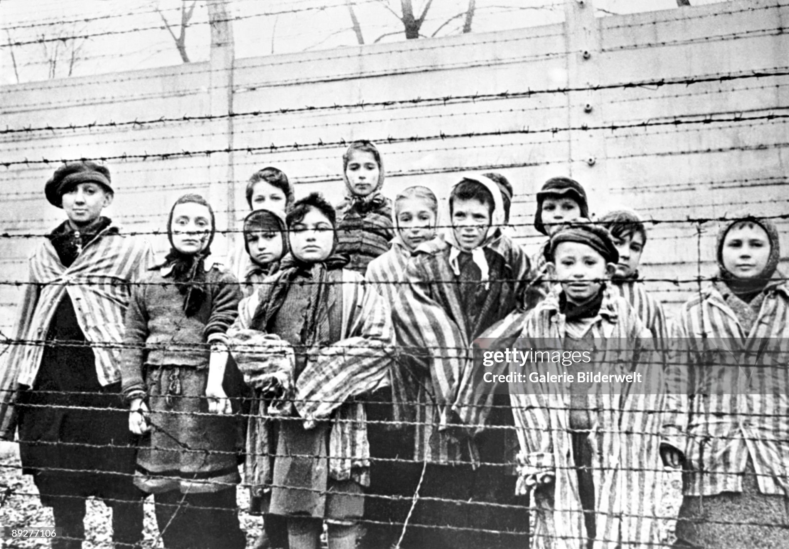
Child survivors Auschwitz

Slide 19
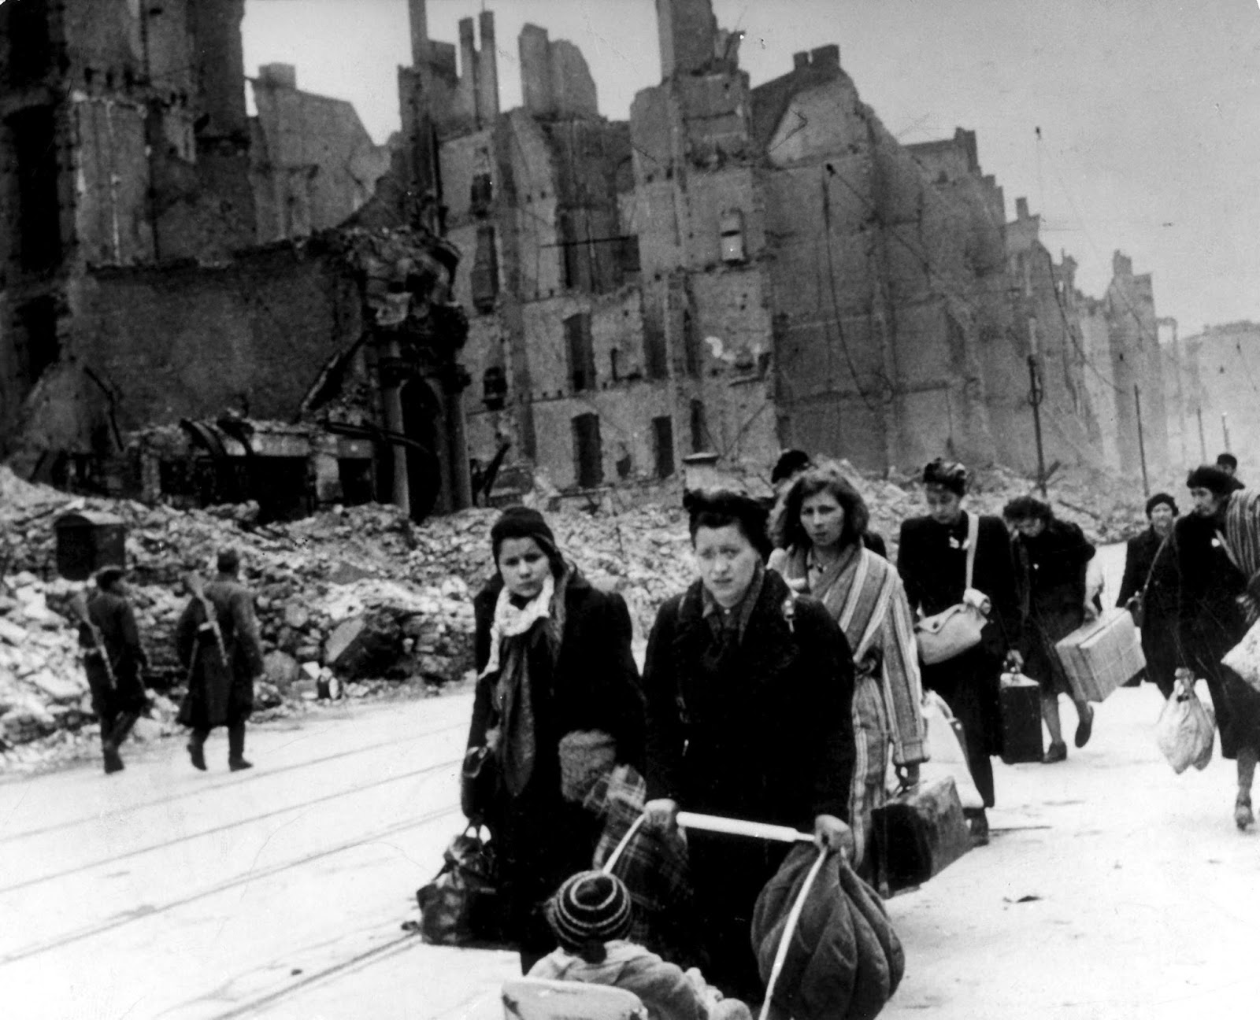
German refugees returning “home”

Slide 20
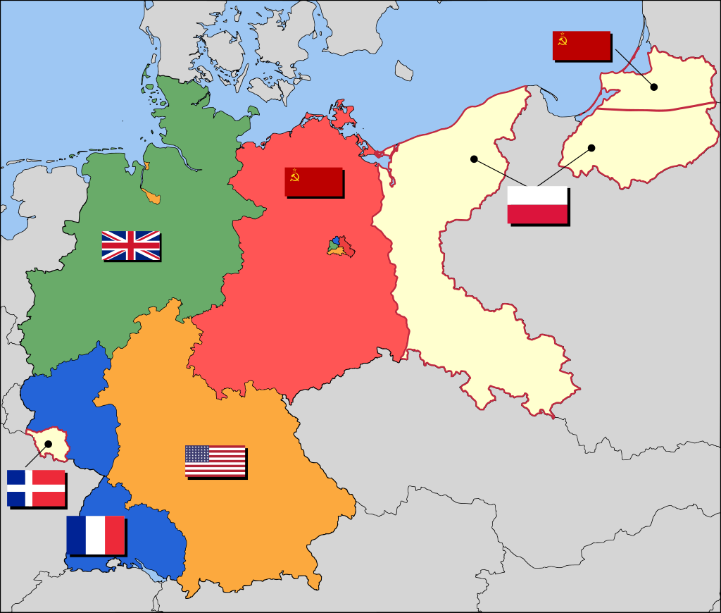
Germany
German territory transferred
To Poland & “ethnically cleansed”
Occupation armies by Nation end 1945
No national government
…currency worthless> barter
economy..cigarettes/ prostitutes
War continues
Baltics : “Forest People” till 50’s
Germany : “Werewolves”
150,000
1.5 million
Armies of Occupation operate
“martial law”…Soviet use army
to remove anything useful
150,000
War crimes Tribunal Nuremberg
…14 Nazi leaders hanged
400,000

Slide 21
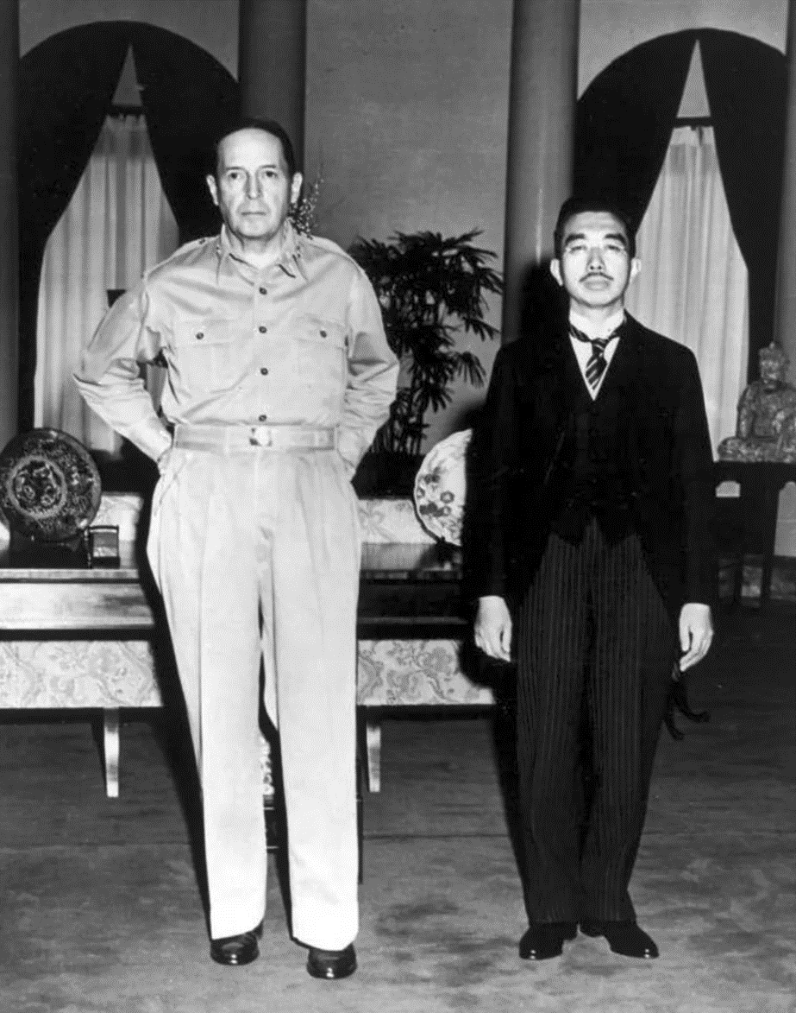
Japan
US occupies Japan
400,000 US soldiers
40,000 British/ Aust
Douglas MacArthur
Emperor Hirohito
Emperor converted to Constitutional monarch
..absolved…despite
evidence of involvement
..Becomes marine biologist
…MacArthur “Dictator”
War crimes tribunal
…Tojo hanged

Slide 22
Japanese Occupation 1945-1949
MacArthur “Dictator of Japan”…Parliament reinstated, submit suggestions
Japan to be de-militarised….colonists to be “humanely relocated” from Korea
First year…prevent starvation….United Nations, Charities, US Aid (loans)
Political prisoners released, Trade Unions allowed, women emancipated
1947 Constitutional Convention…Parliament re-established, labour standards…New Deal
Land Reform…5.8 m acres transferred from Landlords to peasant…
“Reverse Policy” 1949….Cold War…Japan re-industrialised
Power gradually transferred to Japanese, Occupation ends 1952
..US retain bases, 200,000 soldiers during 1950’s…30,000 today

Slide 23
Recreation and Amusement Association
The problem…440,000 young males armed in defenceless country of starving people
The solution…Japanese Authorities devised….” And so we unite and go forward to where our beliefs lead us, and through the sacrifice of several thousands of "Okichis of our era" build a breakwater to hold back the raging waves and defend and nurture the purity of our race, becoming as well an invisible underground pillar at the root of the postwar social order... we are but offering ourselves for the defense of the national polity”
70,000 Japanese women enticed to join….dancers, entertainers, prostitutes
Officially illegal but accepted by Occupation forces/ licensing system 1949

Slide 24
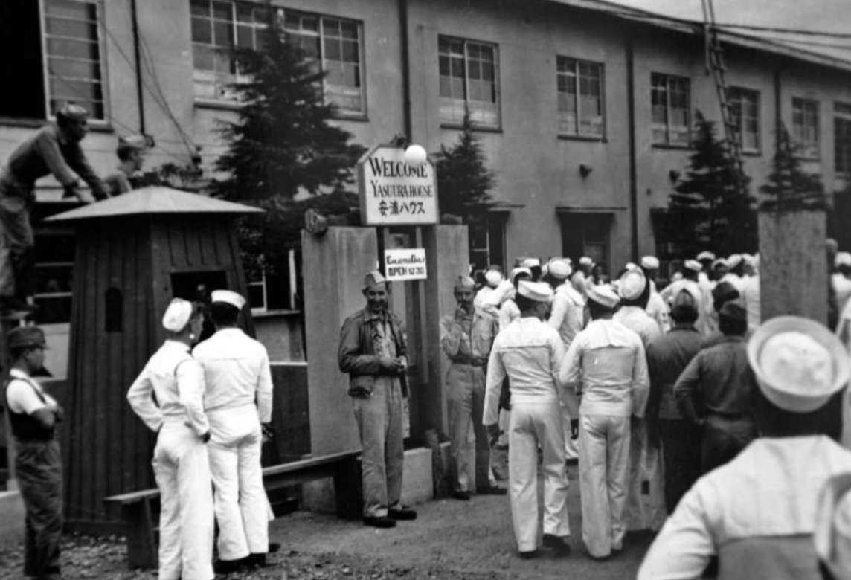
Recreation & Amusement centre 1947

Slide 25
Instability across Europe
Eastern Europe: USSR rig “free and fair” elections to support Communist regimes
Greece: Civil war Communists and Conservatives: British army of occupation
Italy: not occupied, unstable government , strong Communist threat to
France: unstable coalition led by DeGaulle….Communist vs Conservatives
British Palestine Mandate:
British attempt to regulated flow of Jewish survivors
Zionist terrorist groups (former British army veterans)
Everywhere hunger, desolation, uncertainty

Slide 26
United Kingdom Post War
Nation on verge of bankruptcy
Debt has risen 130% to 250% GDP, Deficit to 27% GDP (versus 2.2% December 2024)
Lend Lease programme (no repayment) ends August 1945
£3.5Bn ($57Bn 2024) loan (2% interest) from US..repaid 2006
Global Commitments: Germany, Greece, Palestine, India, Indo China
New Labour Government focused on NHS, Nationalisation,

Slide 27
Europe starving, impoverished, political turmoil …UN no power, no money …USA celebrating, relying on UN, Bretton Woods, British …USSR with 2m soliders deployed, asset stripping, USSR confident, predatory … installing pro Soviet Regimes ….confident Europe about to collapse

Slide 28
USA Post War

Slide 29
USA home front 1941-1945
Rapid growth. Full employment
GDP 75% larger in 1945 than 1949…growth at 10% per year
1% unemployment (women from 20% to 30% worksforce)
Mass migration blacks from South to North/ Mexicans to SW
High savings rate rationing, lack of consumer goods (25% income vs 2% 1920’s)
Financial power of world
Debt rises from 40% to 120% GDP…but debt held internally
Competitors in ruins/ Domestic harmony: No strike laws/patriotic unions/ high trust business
Fears of recession as armed services reduce from 12m to 1.7 m by 1947

Slide 30
Post war boom
Rapid transition from munitions to consumer goods
Economic growth slows but only from 10% to 8%
Spending binge due to 25% average savings during war
Incease in trade (Bretton Woods) increases US trade
Consumer boom
Housing boom: soldiers returning home and GI home loans
Emergence new labour intensive industries …automobiles, radios, televisions, appliances
Baby boom (Marriages rate increase 12 per 19 per 1,000. Babies 19 to 24 per 1,000)
Demobilised soldiers to work or college
GI Bill of Rights….education grants, Guaranteed one year income/ home owners
Men replace women in senior/ technical jobs (retian seniority)
Women revert to clerical jobs/ home owners

Slide 31
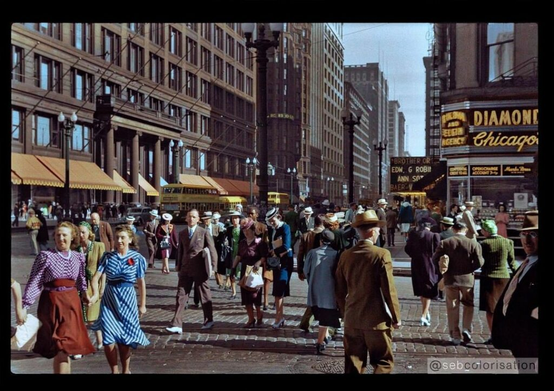
A land untouched by war ……………Chicago 1940

Slide 32
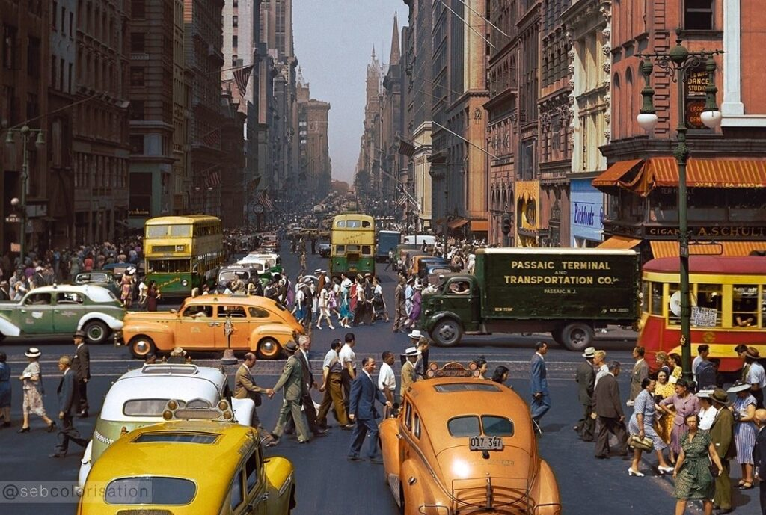
New York City 1946

Slide 33
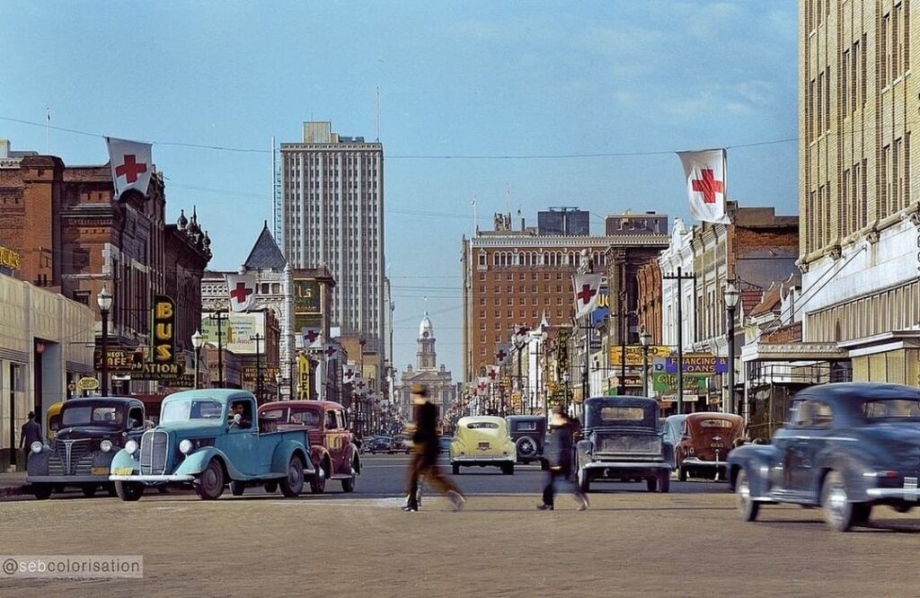
Fort Worth Texas 1942 (new industries to west plus rise of oil industry

Slide 34
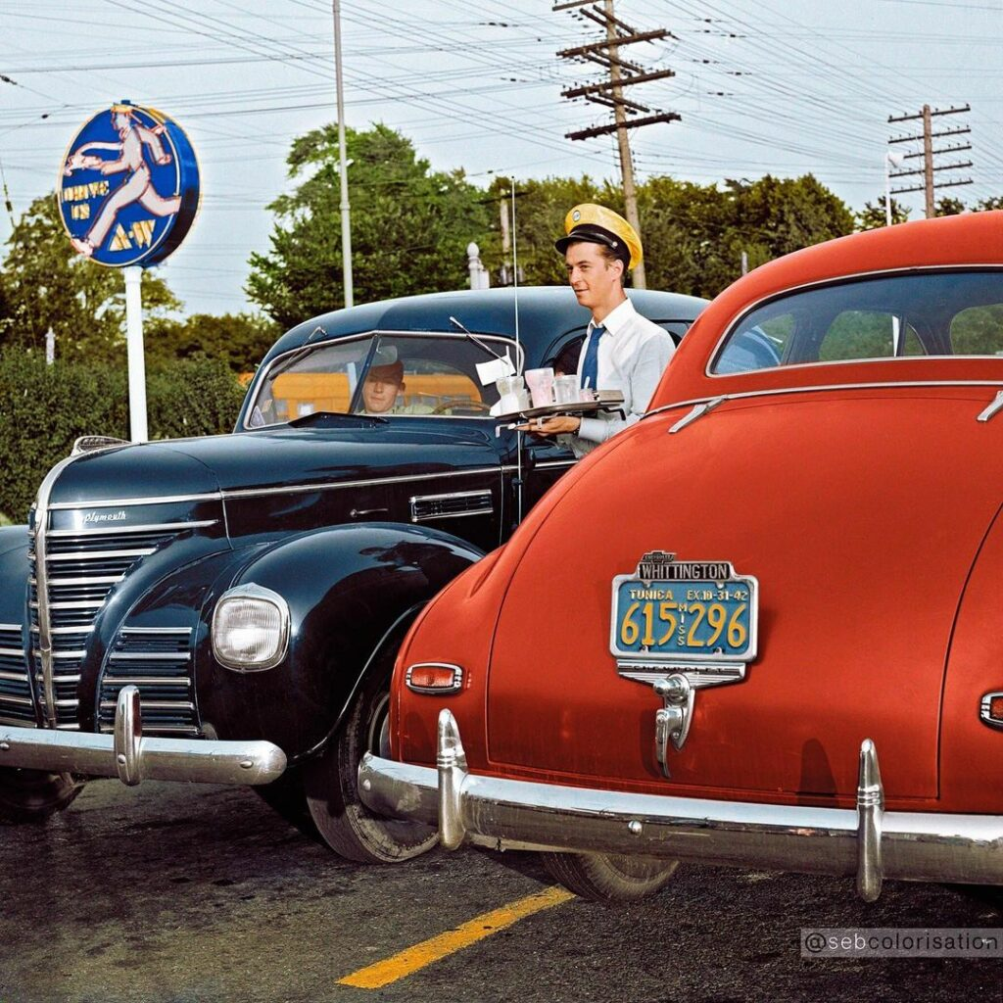
Drive in diners, Philadelphia 1943

Slide 35
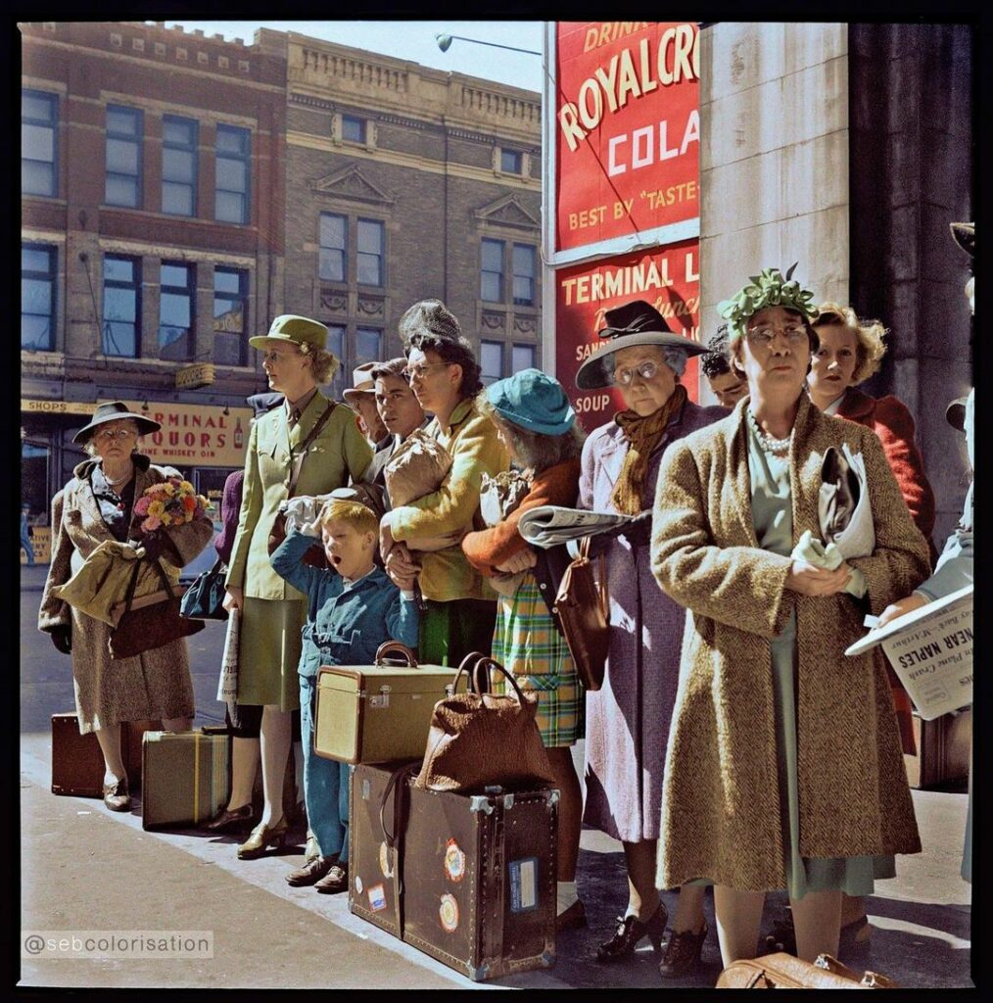
Waiting for the bus, Indianapolis 1943

Slide 36
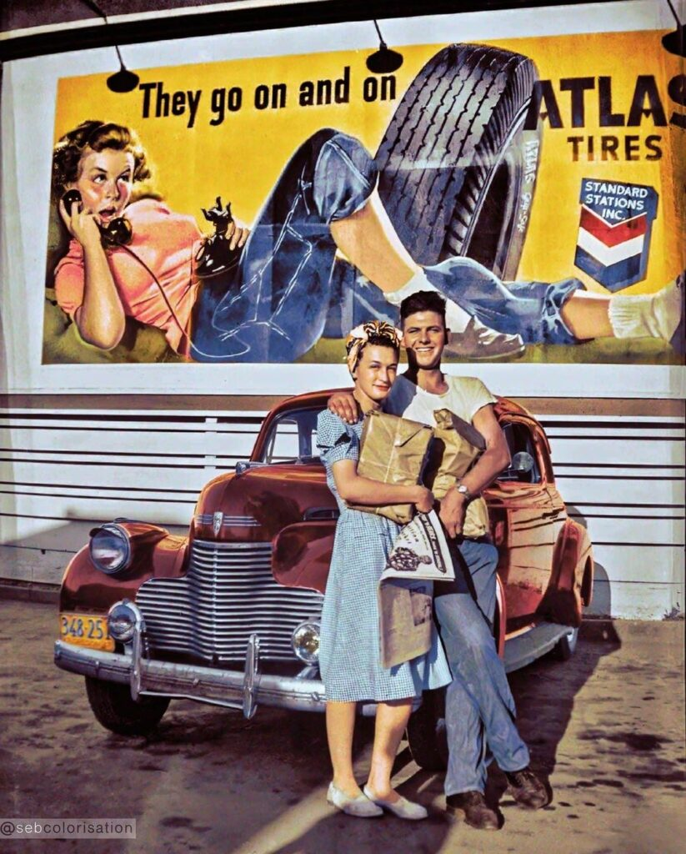
Young couple (back from war ?) Oregon 1945

Slide 37
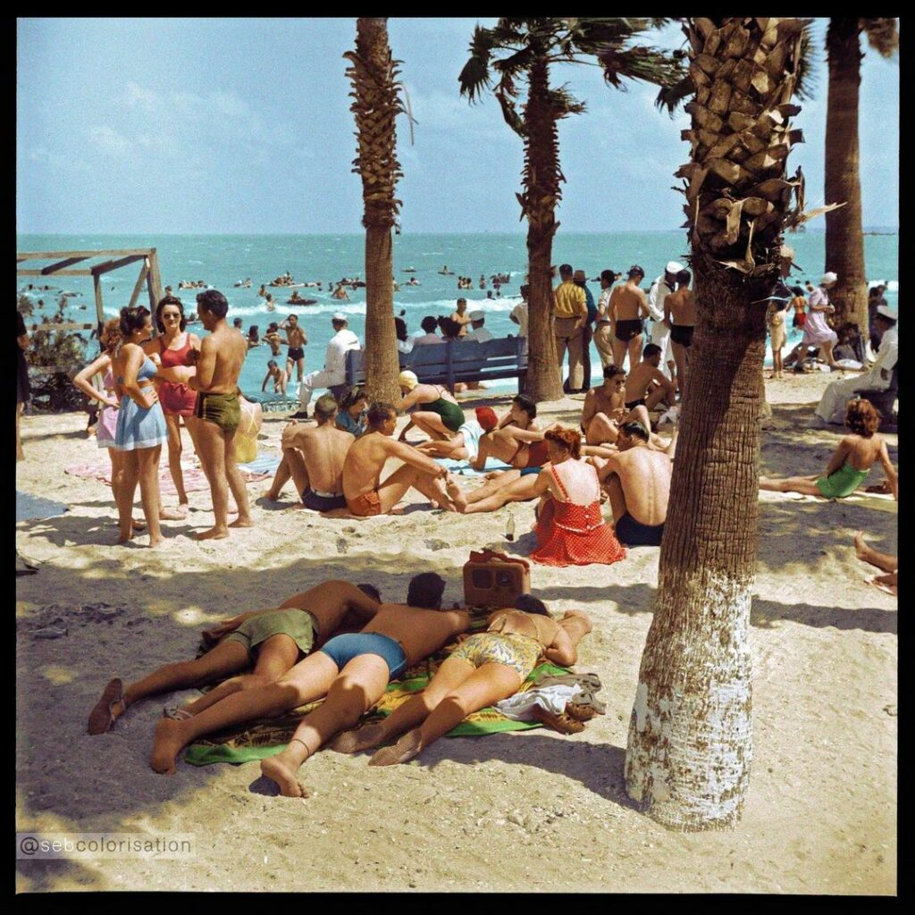
Corpus Christi Texas 1943

Slide 38
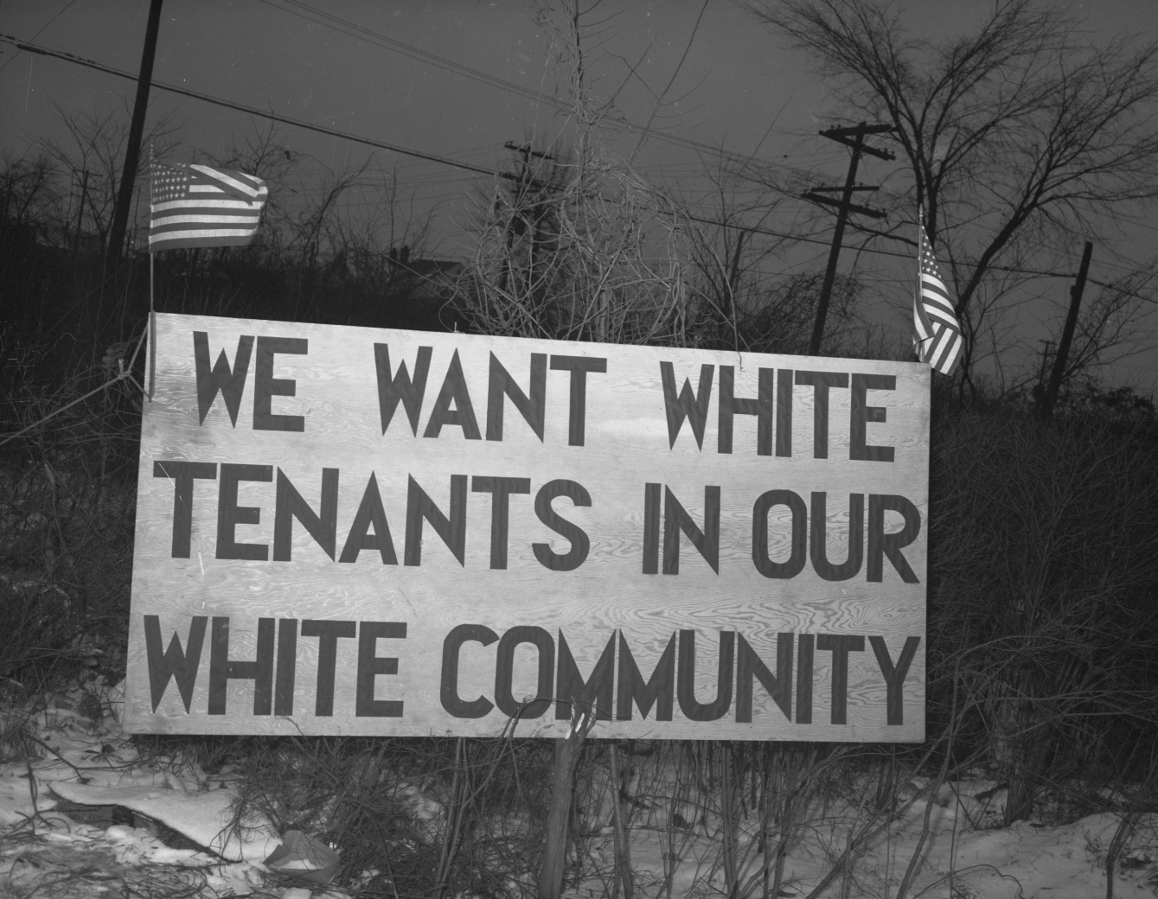
Social unrest….internal migration
Detroit housing complex (1942)
4 million blacks migrate from rural
South to cities…mostly north
Detroit population increases
From 1.5m to 2m 1940-1943
Black population increase 150,000
To 200,000…tensions rise over
Housing/ preferences vs whites
Rumour white threw black women
In river…blacks riot…backlash
50 killed, 6,000 National Guards
Riots in Los Angeles, New York
Beaumont Texas, Mobile Alabam

Slide 39
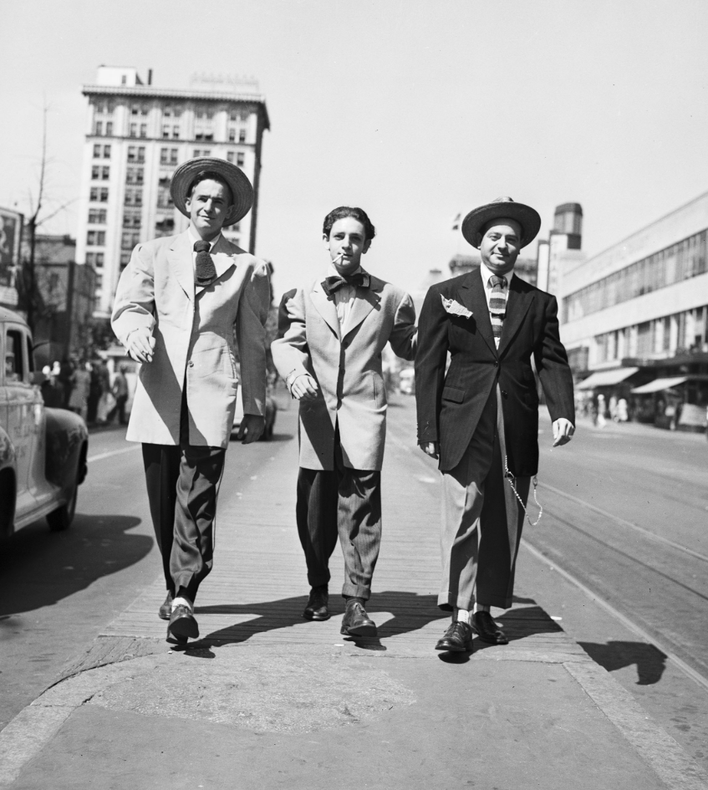
California…influx of “contract labourers
Bracero programme 1942
…contract labour with Mexico…many do not return
“Zoot suits” Los Angeles 1943
Mexican population
Of Los Angeles increased
50% 1940-1945…100,000 to
150,000
Mexican fashion…identiy
Long “zoot suits” ( origins
Duke of Windsor! ..jazz rhyming slant
Cloth rationing…US sailors see
Wearing of suits unpatriotic
…Mexicans as sign of identity
Sailors attack suit wearers
..150 injured/no sailor arrested

Slide 40
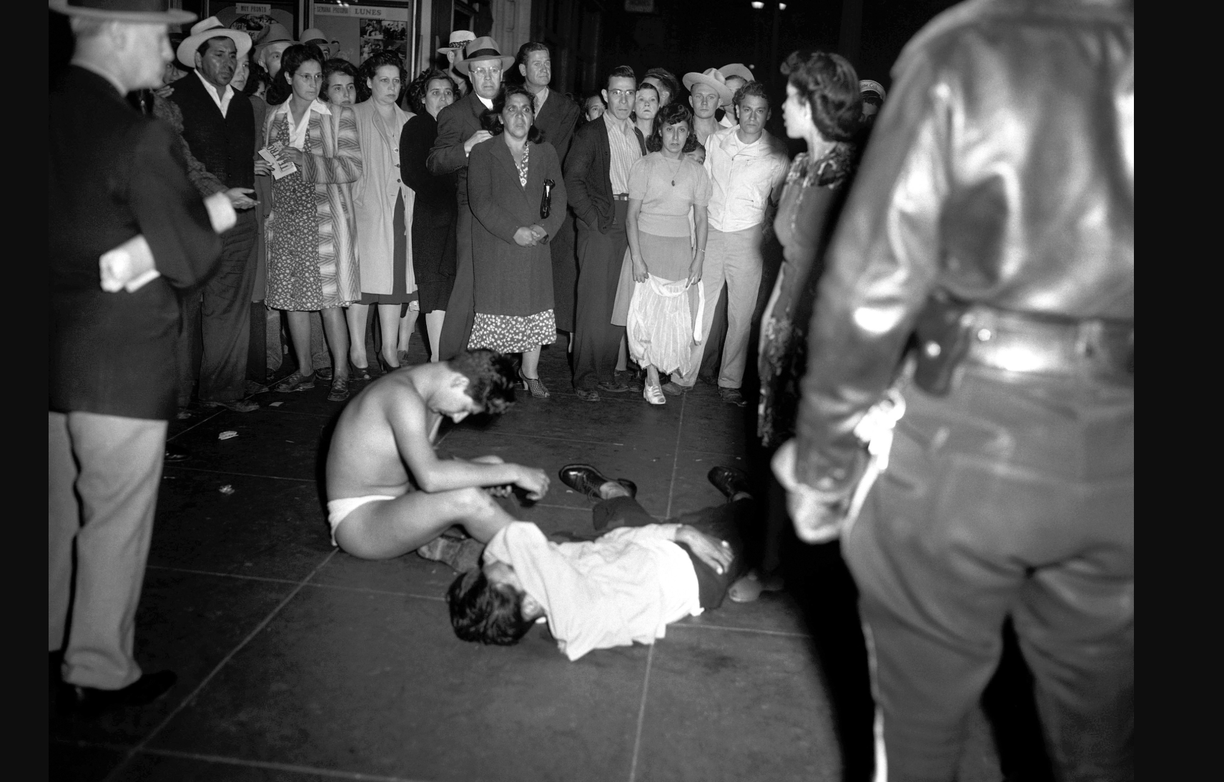
“Zoot suiters” after attack by sailors

Slide 41
Strike Wave 1946 Background
New Deal and Trade Unions
FDR Democrats promote planned prices/ wages/hours
Wagner Act 1935…closed shop, collective bargainining, National Labour Board
Unskilled and Auto workers break off to form Congress of Industrial Workers..industrial unions…regardless of skill
Unions and World War Two
Support war effort : no strike pledge
Wage increases offset by high income taxes
Membership rises to 34% workforce 1945 (vs 55% UK)

Slide 42
Strike wave of 1946
War over…inflation 14%, wae increases 8%....”Deal” collapses
Largest strike wave in US history: steel, autos, coal,
National rail strike May 1946
95% transport stopped/ Truman threatens to draft railway workers
Strikers back down… House passes law…Senate vetoes
Impact…2nd “Red Scare” begins
Media convinced Communists/ Socialist involvement
Evidence Soviet spy rings spreads
Truman “soft of communism”
Republicans gain control of Congress November mid terms

Slide 43
Birth of the Cold War

